Slide 1
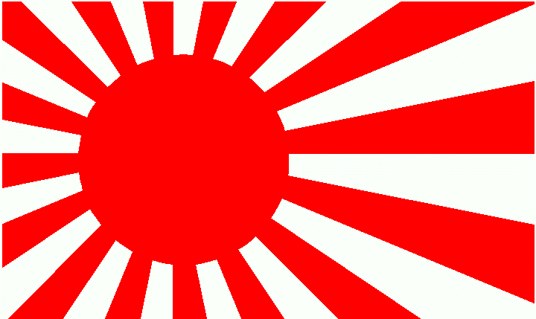
Korematsu v. United States (1944)
Neil Soria
1B
4/13/2013

Slide 2
Description
Early in WWII, President Franklin D. Roosevelt issued Presidential Executive Order 9066 (grants U.S. military the power to ban individuals with Japanese ancestry from areas critical to domestic safety)
Fred Korematsu, a Japanese-American, refused to leave his residence in San Leandro, CA.
Was convicted, and he appealed, which his cased reached the Supreme Court in 1944

Slide 3
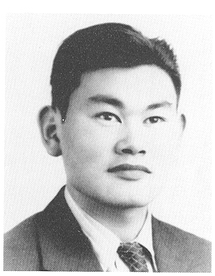
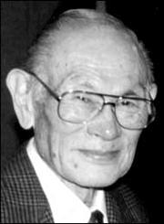
Fred Korematsu

Slide 4
Series of Events
3/21/1942: Fred Korematsu charged
5/19/1942: Presidential Executive Order 9066
5/30/1942: Fred denied Presidential Executive Order 9066, arrested
9/8/1942: Found guilty
5/11/1943: Fred Korematsu case
1/1/1983: legal team filed a writ of coram nobis
1/15/1998: President Bill Clinton awarded him a medal the White House
3/30/2005: Fred Korematsu died in Larkspur, CA at age 86

Slide 5
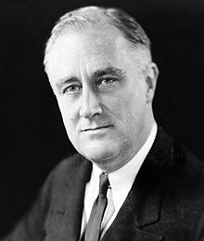
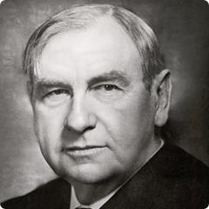
President Chief Justice
Franklin D. Roosevelt
Harian Stone

Slide 6
Essential Terms
Restrictions: a limitation on the use or enjoyment of property, facility, or activity
Ancestry: line of descent
Racial antagonism: relations between members of two or more human races, especially in a single community
Internment camps: camp for prisoners of war
Segregation: separation or isolation of a race, class, ethnic group by enforced or voluntary residence of a restricted area
Euphemism: substitution of an agreeable expression for one that may offend or suggest something unpleasant
Prejudice: injury or damage resulting from some judgment or action of another in disregard of one’s rights

Slide 7
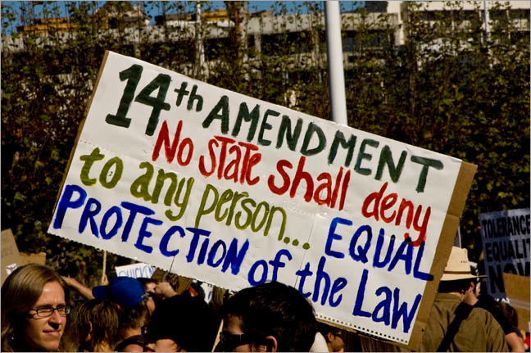
Constitutional violation
14th Amendment

Slide 8
Opposing Viewpoints
Mr. Justice Murphy: “Such exclusion goes over ‘the very brink of constitutional power’ and falls into the ugly abyss of racism.” “I dissent, therefore, from this legalization of racism. Racial discrimination in any form and in any degree has no justifiable part whatever in our democratic way of life. . . .”
Mr. Justice Jackson: “I should hold that a civil court cannot be made to enforce an order which violates constitutional limitations even if it is a reasonable exercise of military authority. The courts can exercise only the judicial power, can apply only law, and must abide by the Constitution, or they cease to be civil courts and become instruments of military policy.” “I would reverse the judgment and discharge the prisoner.”

Slide 9
Court Opinions
Majority Opinion: Mr. Justice Black
Although not all restrictions are unconstitutional, the courts are to judge their rigid scrutiny, the intensity of the matters
Concurring Opinion: Mr. Justice Frankfurter
Although it doesn’t state in the Constitution which denies Congress to enforce a military power, it also doesn’t clearly state the extent of military measures
Dissenting Opinion: Mr. Justice Roberts
“The petitioner, a resident of San Leandro, Alameda County, California, is a native of the United States of Japanese ancestry who, according to the uncontradicted evidence, is a loyal citizen of the nation. . . .”

Slide 10
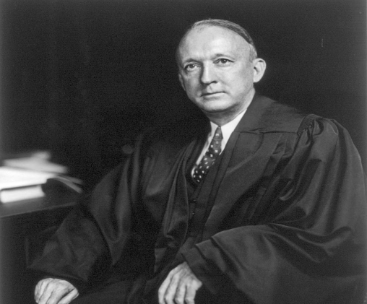
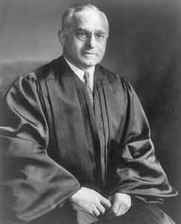
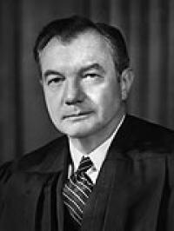
Court Justices
Hugo Black
Felix Frankfurter
Robert Jackson

Slide 11
Significance of the Decision
This decision was made by the Supreme Court because they were under the heat of WWII. They had the pressures of sabotage by the enemy nation, so they took instances to protect America’s national security by imprisoning Japanese-Americans in internment camps.

Slide 12
Personal Opinion on the Court’s Decision
I personally feel that the Supreme Court shouldn’t have made the decision to uphold the Presidential Executive Order 9066. Although it may have helped with our nation’s security at that time, it greatly attacked segregation, discrimination, and prejudice against a group of people, the Japanese-Americans. I think that discrimination with any race should be justifiable in court or any law.

Slide 13
Works Cited
Sources
http://www.pbs.org/wnet/supremecourt/personality/landmark_korematsu.html
http://www.timetoast.com/timelines/105363
http://historymatters.gmu.edu/d/5151/
Pictures
http://3.bp.blogspot.com/_LtYIyDr0KDA/TEml_Xim4BI/AAAAAAAAAJQ/4ZK-66U2Uis/s1600/japanese_flag.gif
http://korematsuinstitute.org/wp-content/uploads/2012/06/Fred-Korematsu-young.jpg
http://www.rightsmatter.org/biographies/Fred)Korematsu.gif
http://upload.wikimedia.org/wikipedia/commons/thumb/b/b8/FDR_in_1933.jpg/220px-FDR_in_1933.jpg
http://c250.columbia.edu/images/c250_celebrates/remarkable_columbians/240x240_bio_stone.jpg
http://hulshofschmidt.files.wordpress.com/2012/07/14am.jpg
http://skepticism-images.s3-website-us-east-1.amazonaws.com/images/jreviews/Hugo-Black.jpg
http://www.duhaime.org/Portals/duhaime/images/Felix_Frankfurter.jpg
http://imgs.sfgate.com/blogs/images/sfgate/crime/2010/09/21/Jackson200x266.JPG

